Slide 1
Alternate Data & Investment Strategy
Option 3
Dhairya Dhamani

Slide 2
Alternate Data: Sentiment Dataset
01

Slide 3
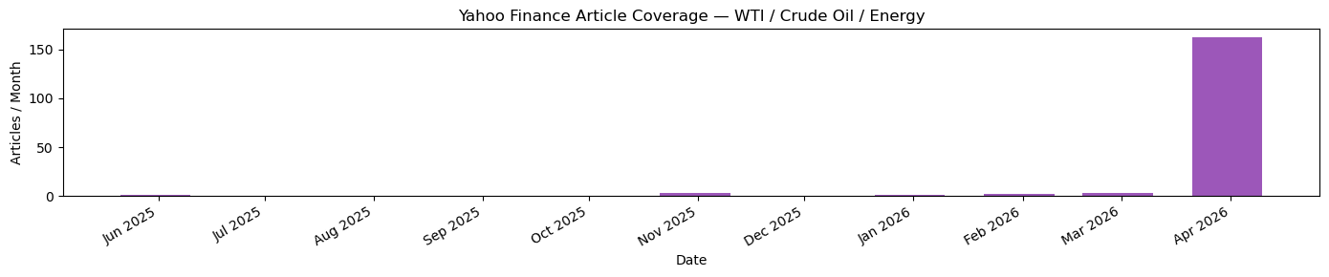
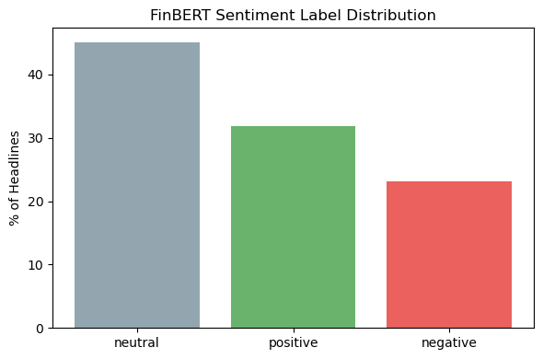
News Sentiment Pipeline
Finance & FinBERT
Data Collection Pipeline
Fetch
yfinance pulls 21 energy tickers and saves as CSV
Apr 2026 spike = most recent fetch; earlier months show steady coverage
Score
FinBert classifies headline as pos/neg/neu -> converts to signed score (+/- conf or 0)
Aggregate
Grouped by date -> 7 daily features

Slide 4
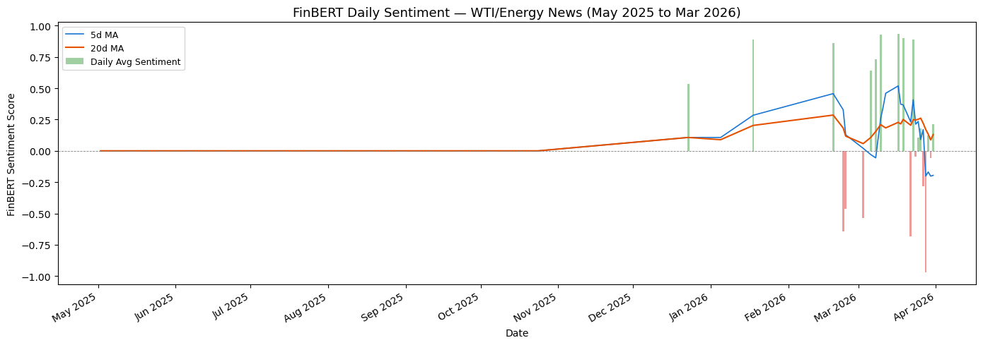
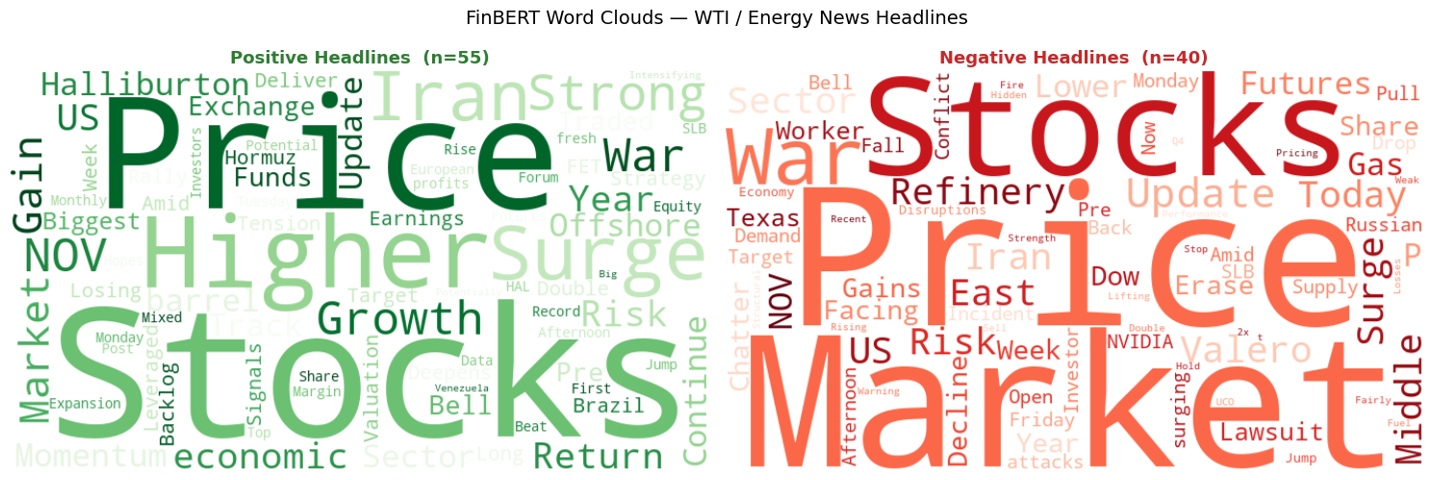
Sentiment Features
Analysis & WTI Integration Design
Proof of Concept: Integration w/ WTI
Base Features
31 Macro + 30 lagged prices
Sentiment
avg_sentiment, pos_pct, neg_pct, sent_5d_ma
Sparse coverage before Mar 2026 reflects API recency limit
No Leakage
Sentiment features shifted 1 trading day
Gap Filling
Forward-fill missing sentiment (up to 5b days)

Slide 5
Investment Strategy
02

Slide 6
WTI Direction-Based Strategy
Long-Short, Confidence-Filtered, Ensemble, Baseline: Buy & Hold
Long-Short
Confidence-
Filtered
Ensemble
+1 (Long) if model predicts UP
−1 (Short) if model predicts DOWN
+1 / −1 when
|prob − 0.5| > θ
0 (Flat) when uncertain
Average XGBoost +
MLP+EN probabilities
then apply ensemble θ
Position Sizing
Edge
Trades every day
Captures every signal
Avoids low-conviction trades θ tuned on validation set only
Combines both models More robust signal
Models
Threshold
Costs
XGBoost,
MLP + Elastic Net
Threshold θ tuned on val period only → applied frozen to test period
Transaction cost: 0.05 % per trade modeled

Slide 7
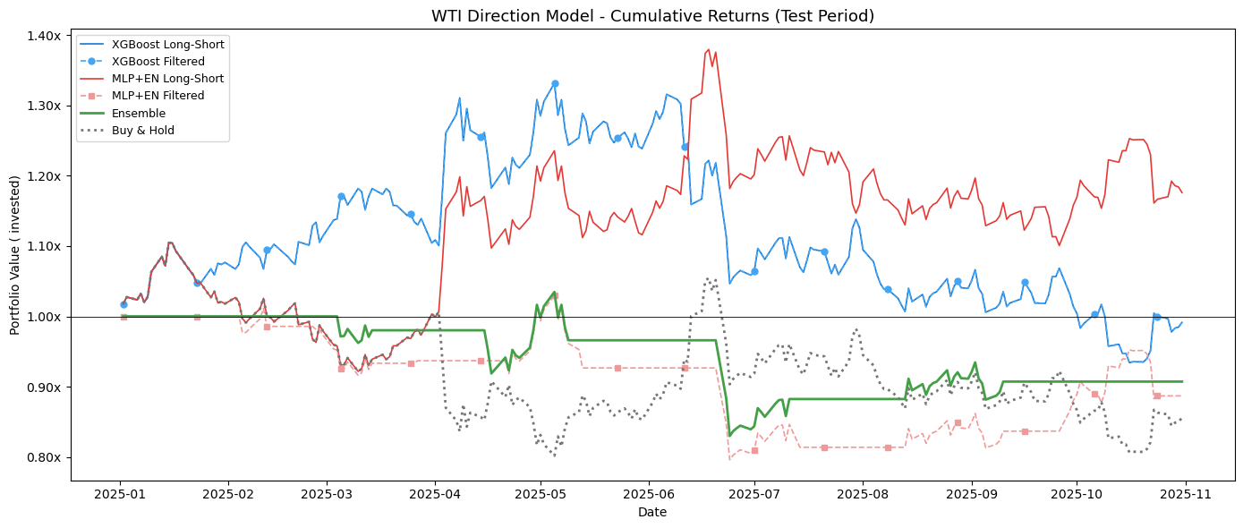
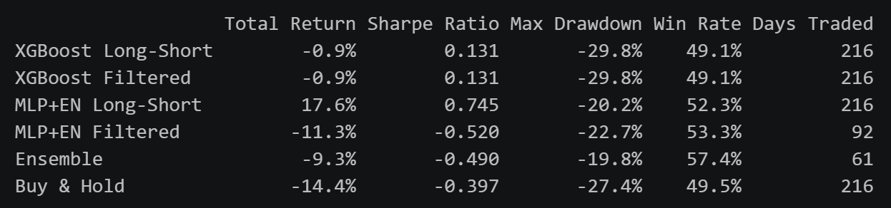
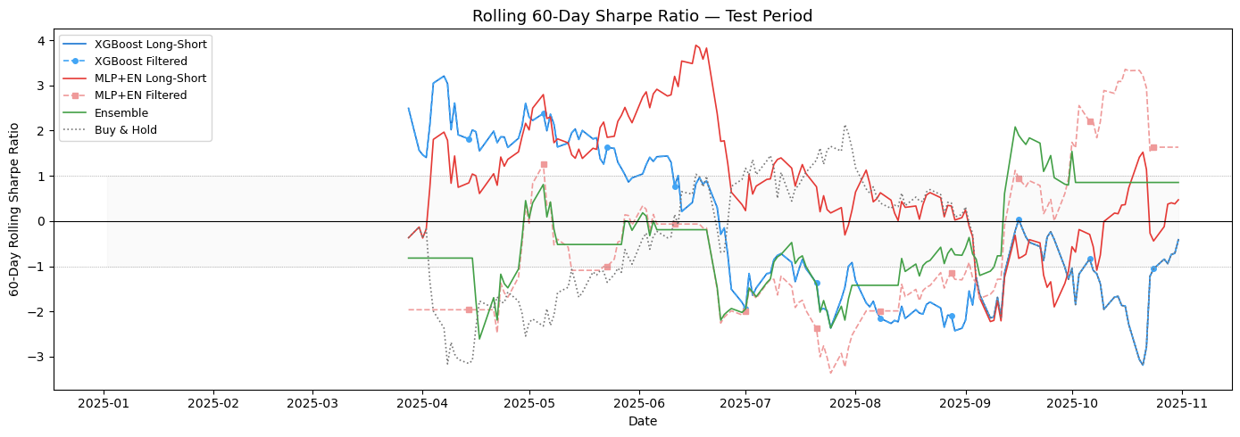
Investment Strategy Results
MLP+EN Long-Short outperformed all strategies at +17.6% (Sharpe 0.745), while Buy & Hold lost 14.4% as WTI declined through the test period.
The rolling Sharpe confirms the edge was consistent, not a one-month anomaly.

Slide 8
Thank You

